Slide 1
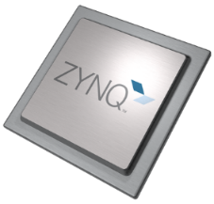
Platform on Chip: Industrial Automation in the IIoT
PS (Processing System)
Fast and deterministic
for realtime networking
Deep learning
for situational awareness
Safety and Security
Perihery
High Speed Connectivity
Quad core performance
for differentiating SW applications
Quad core
Application Processing Unit
Cortex A53
Real Time Processing Unit
Cortex R5
MAC
PL (FPGA Logic)
User-configurable I/Os
for scalable platforms
Built-in Memory
DSP power
for transcoding
DSP
Industrial Network
Sensor Fusion
User Function
Built in hardmacros, memory and mixed signal
for analytics and system monitoring
Deep Learning
Only
Xilinx Zynq UltraScale+ MPSoC
combines all elements for a real Platform-on-Chip
Custom I/O Protocols
ADC

Slide 2
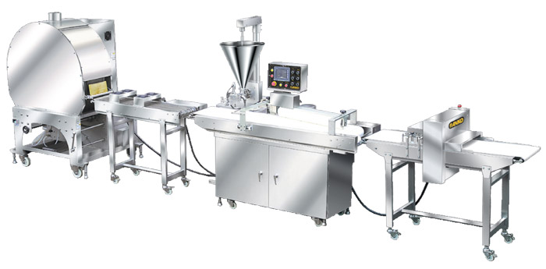
Platform-on-Chip for Connected Industrial Automation
Cloud connected
Safe Edge Controller
with PLC runtimes
Situational Awareness with Machine Learning
with Vitis AI
with Python-based customization
Deterministic Networking
with TSN Endpoints
with Industrial Ethernet
with embedded processors for Safety protocols
Sensor and Actuator Connectivity
with HiperFace DSL, EnDat, BISS
with I²C, SPI, sensor buses
with USBVision, Coax Express
I/O
HMI
Drives
Sensors
Image Sensor
Controller
Networks
Safety
Security
Notes:
Xilinx and the partner ecosystem have understood this and provide solutions for all areas so that Xilinx plays in all parts of an automated industrial process, regardless if it‘s for the controller, the networking function, data acquisition and – of course – Machine Learning.

Slide 3
Industrial Automation with Xilinx's Solutions Stack
Curated solutions for the intelligent Edge
Maintained by Xilinx and Xilinx’s partner ecosystem
Industrial IoT and Healthcare Solutions Stack
HMI, PLC runtimes, Cloud Service clients
APPLICATION
EDGE AI
Deep Learning Processor (DPU), Python analytics
Hypervisors w/ Cache Coloring
EMBEDDED SW FOR MIXED CRITICALITY
ANY-TO-ANY CONNECTIVITY,
SMARTER CONTROL, EMBEDDED VISION
TSN, EtherCAT, Profinet IRT, HSR, PRP, MIPI CSI, SLVS-EC, GigE Vision, USB Vision, FOC
FUNCTIONAL SAFETY & CYBERSECURITY
IEC 61508 Certified Design Flow w/ Vivado
IEC 62443 stack, triple modular redundancy
SILICON ARCHITECTURE
AXI Infrastructure, ADC, Vision CoDec, GigEthernet, QSPI, I²C, USB
Notes:
To accelerate platform design Xilinx has invented the Industrial IoT and Healthcare Solutions Stack with the best from Xilinx in-house development and Xilinx‘s Partner ecosystem. Functional Safety is an essential part of the Solutions Stack. We have a Center of Excellence with the competence to drive Safety and Security continuously forward to cost, time and effort optimized approaches.
The availability of subsystems is a high value for platform creation. Applying this has the following benefits:
Xilinx Functional Safety lowers the risk through fast prototyping and programmability to add changes during the design process.
Xilinx Functional Safety lowers cost through integration and removal of complexity from boards (less issues with signal integrity) as well as the reduction of I/O circuitry (e.g. Resource consuming mapping/demapping functions).
Xilinx Functional Safety optimizes the time to Market because Xilinx‘s available deliverables allow fast and eary interaction with assessors.

