Slide 1
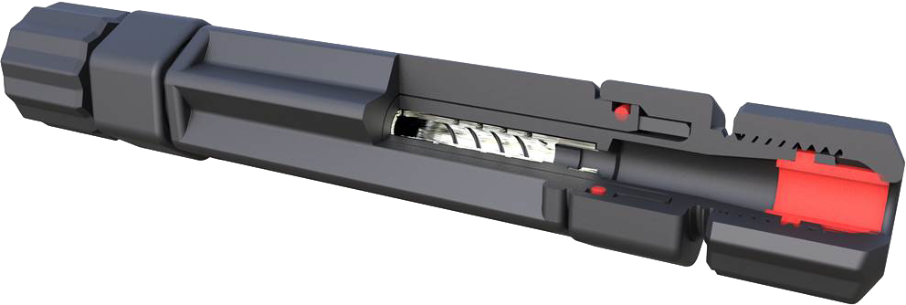
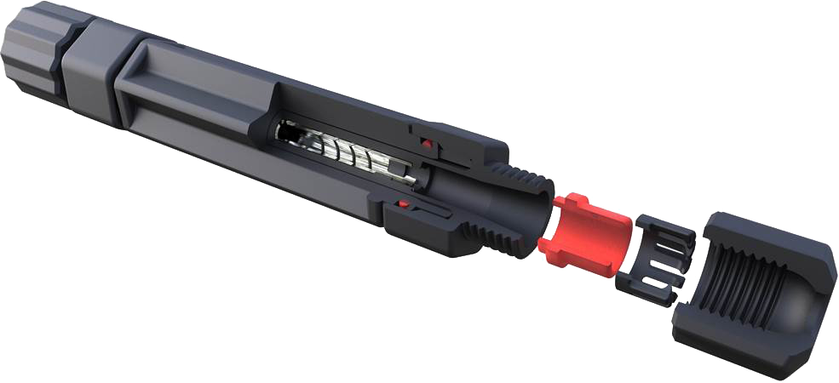
RadCrimp™ Solar Splice
with Melni Spiral Termination Technology
Notes:
Welcome to the Amphenol Industrial Operations’ RadCrimp Solar Splice with Melni Spiral Termination Technology product training module. The presentation will introduce the RadCrimp Solar Splice system. It will cover the features and potential application markets for these connectors and highlight mechanical, environmental, safety, and electrical characteristics. The tutorial will review the part number information for the parts in the series and present typical applications.
The RadCrimp Solar Splice is a field installable solar connector, eliminating the timely process of crimping, the need to buy expensive crimping equipment, and is an overall quicker, safer solution than the PV connectors of the past.
Amphenol’s RadCrimp Solar Splice is environmentally sealed, features innovative Melni Spiral Termination Technology which offers low resistance and reliable safe and simple terminations.

Slide 2
Features & Markets
Features
Markets & Applications
Features Melni Spiral Termination Technology
Simple and fast termination
Field termination and sealing without special tools
Low resistance wire termination and sealing in one action
IP68 Sealing protection
Innovative Melni Spiral Termination Technology is low resistance and reliable
UL Certified
Solar Energy
Notes:
RadCrimp Solar Splice features Melni Spiral Termination Technology making solar field termination and sealing without special tools possible. This low resistance wire termination and sealing in one action technology provides an IP68 protected reliable connection that is UL certified.
The major applicable markets include but are not limited to: Solar Energy

Slide 3
Specifications
ITEMS | SPECIFICATION
Rated Voltage | UL6703 1500V DC
Rated Current ( UL) | 20A(4.0mm2/12AWG), 30A(6.0mm2/10AWG)
Typical Contact Resistance | ≤ 0.10mΩ, TYP
Insulation Material | Thermoplastic (PC/PA)
Contact Material | Tin over nickel plated copper alloy
Cable Strain Relief | Compression sealing gland featuring cable insulation gripping collet and torque specified sealing cap
Application Class | Class A
Over Voltage Category | III
Degree Protection | IP68 (1 meter, 1 hour) mated
Flame Class | UL94-V0
Cable OD Range | Ø6.0mm ~ Ø7.4mm
Cable Strands Range | 7 ~ 60 strands
Pollution Degree | 2
Safety Class | Class II
Ambient Temperature Range | -40°C ~ +85°C
Upper Limiting Temperature | 120°C
UV Resistance | Outdoor suitable (f1) rated materials, per UL746C
Notes:
The specifications: The RadCrimp Solar Splice connector’s mechanical and electrical specifications highlight the performance standards of this series. Using quality shell components made from Thermoplastic (PC/PA). These connectors can live and thrive in industrial climates. With an operating temperature range of -40°C to +85°C. The ingress protection of the RadCrimp Solar Splice is IP68 in the mated condition with a voltage rating of 1500V and up to 30 amps. The RadCrimp Solar Splice features tin over nickel plated copper alloy contacts and has a flammability rating of UL94-V0.

Slide 4
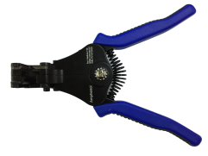
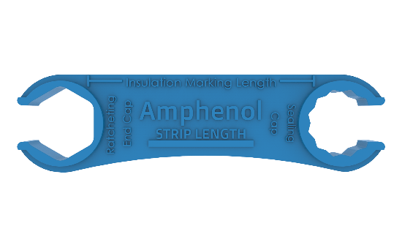
How to Order
Product Code : AMPVSTS4S
Strip Tool
Wrench Tool
Notes:
Part number information regarding the RadCrimp Solar Splice. References for each part number attribute are followed by a description and additional information of said part number.

Slide 5
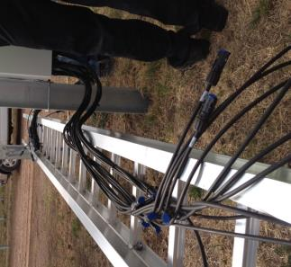
Applications
PV Installation
Notes:
The major application for the RadCrimp Solar Splice are Solar PV Installations.

Slide 6
Summary
The RAD-Crimp® Solar Splice with Melni Spiral Termination Technology
Designed for photovoltaic installations
Features Melni Spiral Termination Technology
Low resistance wire termination and sealing in one action
Field termination and sealing without special tools
Certified to UL6703 for 1500V DC
Current rating of 20A(4.0mm2/12AWG), 30A(6.0mm2/10AWG)
IP68 (1 meter, 1 hour) mated means perfectly suited for outdoor applications
Notes:
In summary, the Amphenol RadCrimp Solar Splice with Melni Spiral Termination Technology is ideal for Solar applications and affords low resistance toolless wire termination in one action. The connector is UL certified for 1500 DC and can carry up to 30 amps. In the mated condition the RadCrimp Solar Splice has an IP68 rating, and is backed by the Amphenol name.

