Slide 1
Channel NPI
Relative Humidity Sensor
November, 2017

Slide 2
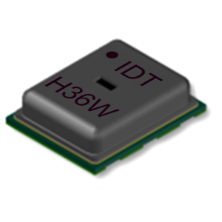
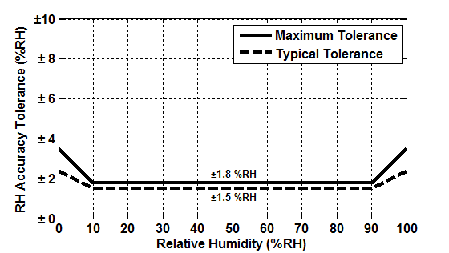
HS300x Product Snapshot Humidity Sensor with Industry Leading Accuracy, Response Time, and Excellent Stability
Features
Benefits
Applications
±1.5% Relative Humidity Accuracy (HS3001)
Fast RH response time (Typical 6 seconds)
14-bit resolution, 0.01%RH (Typical)
Low power consumption, 1.0µA average (one RH + T measurement per second)
Temperature sensor accuracy of ±0.2°C (HS3001, HS3002)
Extended supply voltage, 1.8V to 5.5V
Silicon-carbide capacitive sensing element
Excellent stability against aging
Highly robust protection from harsh environmental conditions and mechanical shock
Very low power consumption
Digital I²C Output
Climate control systems
Home appliance
Weather stations
Industrial automation
Process controls and monitoring
Automotive climate control
Medical equipment
High RH Accuracy and Long Term Stability You can Depend On
HS3001 Accuracy at 25 °C
HS3001 Accuracy over Temperature
Notes:
2
This is the standard One page snapshot.

